Slide 1



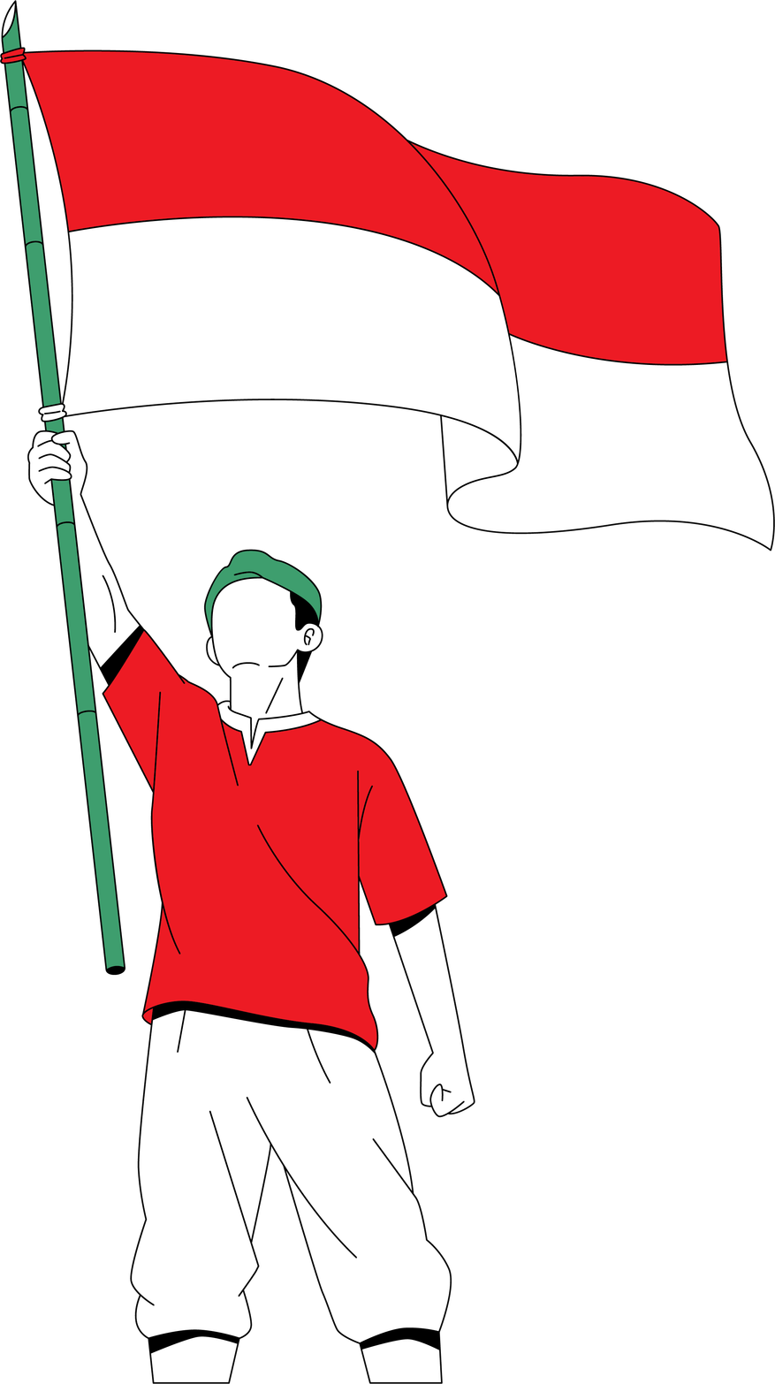

Bahasa Indonesia: 17,000 Islands, One Voice
Discovering the World’s Most Logical Language

Slide 2
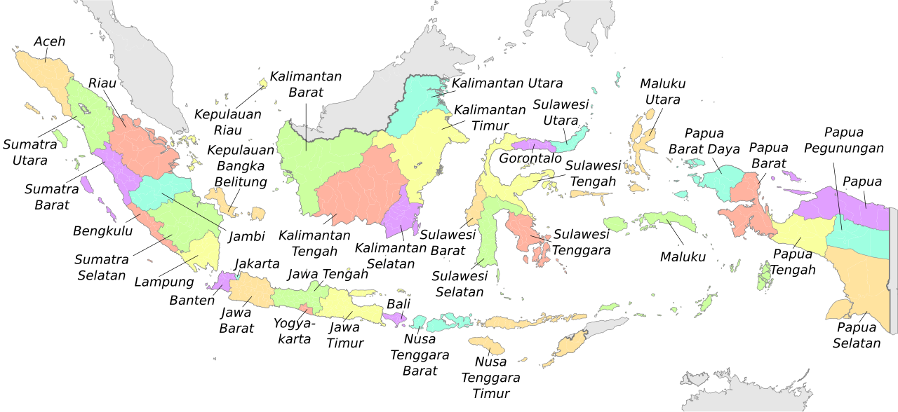
17,000
Islands
1,300
ethnic groups
718
distinct languages
Notes:
"Welcome! Today, we’re diving into the heart of a hidden giant. To understand the Indonesian language, you first have to grasp the sheer physical scale of the place.
Indonesia isn't just a country; it’s a massive sprawling archipelago of 17,000 islands. Those islands became home to over 1,300 ethnic groups speaking 718 distinct languages.
I’m not talking about different accents or dialects. A person from North Sumatra and a person from Papua are as linguistically different as a German and a Greek.

Slide 3
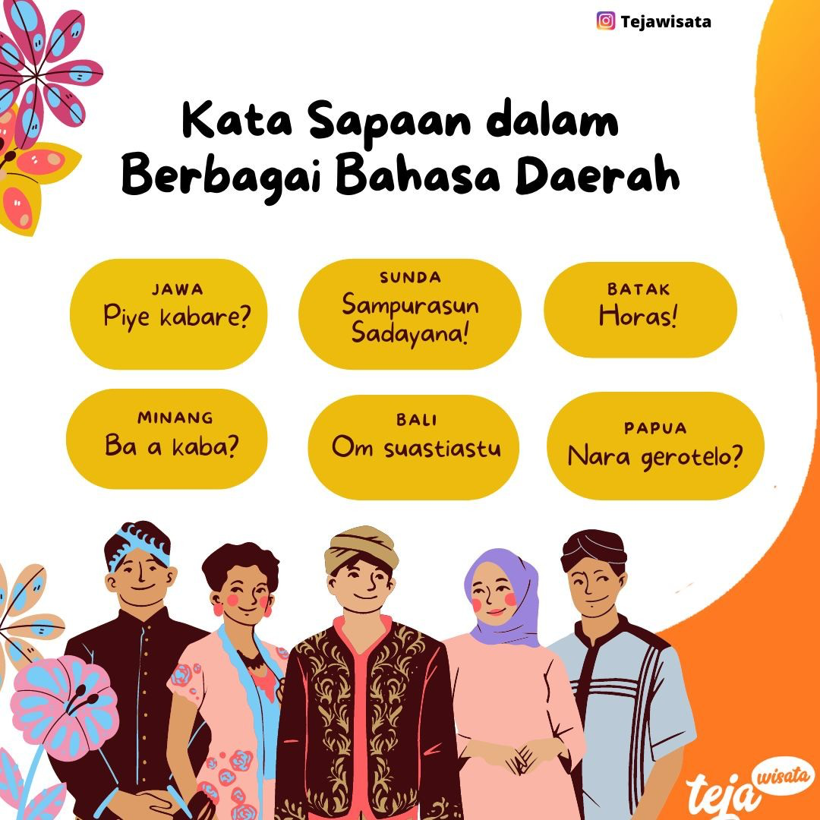
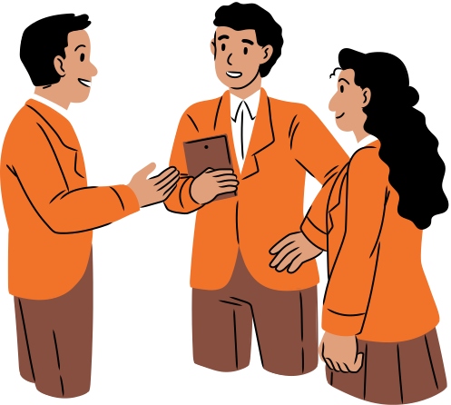
How Different Ethnic Say “Hello”
Notes:
To show you exactly what that looks like in practice, look at this screen. These are just six ways to say 'Hello' or 'How are you' across the archipelago. Take a second to look at them:
In the heart of Java, they say Piye kabare?
Travel a few hours to West Java, and it's Sampurasun Sadayana!
Go to Sumatra, and you have the Batak people shouting Horas! while the Minang people say Ba a kaba?
Then you have the poetic Om Suastiastu in Bali and the completely unique Nara gerotelo? in Papua.
For centuries, these cultures were 'linguistically stranded'—living side-by-side but unable to understand a single word their neighbors said.

Slide 4
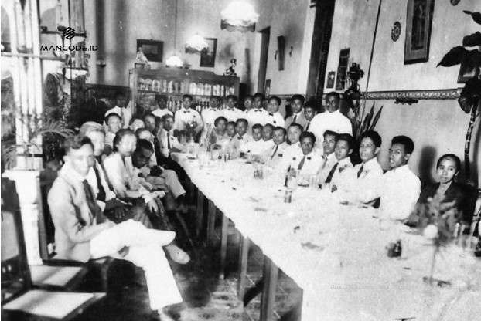
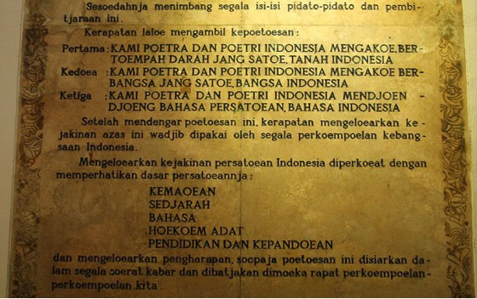
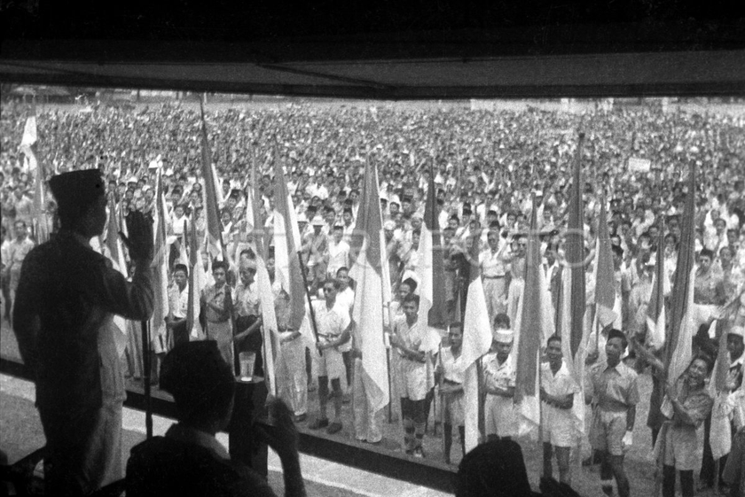
1928: The Youth Pledge (Sumpah Pemuda)
Malay
Bahasa Indonesia
Notes:
"In 1928, Indonesia was still a Dutch colony. A group of young student activists from across the islands gathered for the 'Second Youth Congress.' This event is known as the Sumpah Pemuda, or the Youth Pledge.
They realized that to kick out the colonizers, they needed a unified identity. They famously pledged: One Motherland, One Nation, and One Language. But which language? They chose Malay. Why? Because Malay was already the 'lingua franca' of the markets. It was a neutral language. It didn't belong to any one powerful ethnic group, making it the perfect 'political' choice. They renamed it Bahasa Indonesia to give it a fresh, national soul."

Slide 5
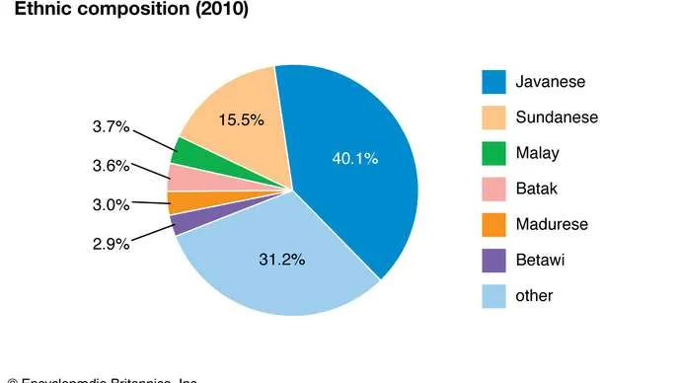
Why not just pick the most popular language?
Notes:
"Now, you might wonder: 'Why not just pick the most popular language?' At the time—and still today—the Javanese people were the largest ethnic group, making up nearly 40% of the population. Their language is beautiful, but it had a 'problem' for a new democracy: Social Tiers.

Slide 6
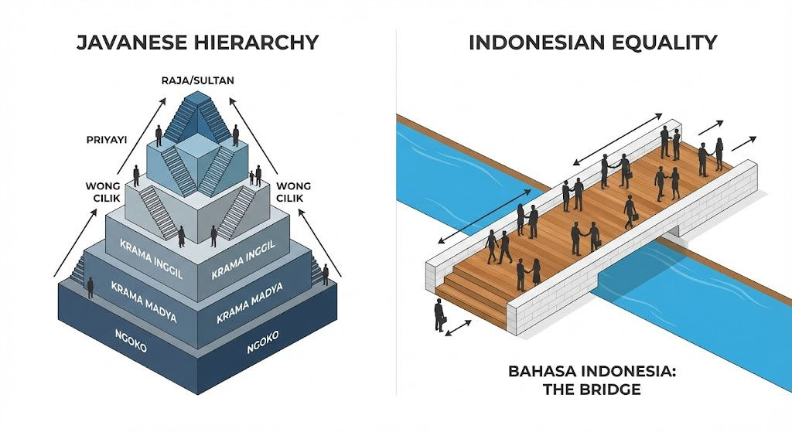


Notes:
In Javanese, you use entirely different words depending on whether you are speaking to a superior, an equal, or a subordinate. It is a language built on hierarchy. The founders of Indonesia realized that if they chose Javanese, everyone else would feel like second-class citizens. By choosing the 'flatter,' simpler Malay-based Indonesian, they ensured that a taxi driver and a President could speak the exact same words to each other. It was a choice of equality over tradition."

Slide 7
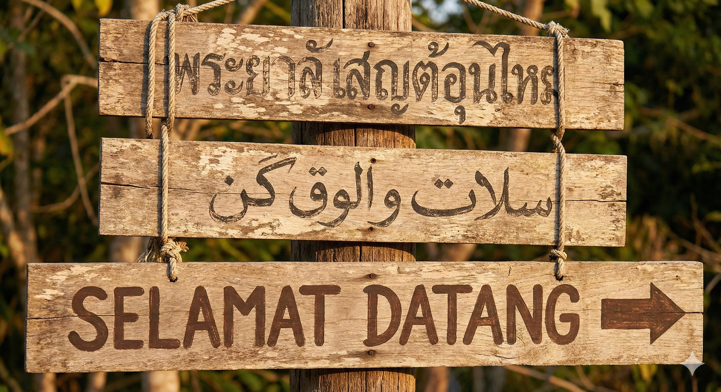
Notes:
"Now, take a look at this signpost. It’s a perfect visual metaphor for the linguistic choice Indonesia made.
The High Walls (Top & Middle): The top two signs are beautiful, but for most of us, they are a mystery. The middle one is especially important because, for centuries, the Indonesian language was actually written in Jawi—an adapted Arabic script. It was the language of scholars and royalty, but it wasn't easy for everyone to master.
The Open Door (Bottom): But look at the bottom sign. 'SELAMAT DATANG.' You can read it instantly. You know the letters, you know the sounds. It simply means 'Welcome.' The Strategic Choice:
In the early 20th century, Indonesian leaders realized that to build a modern, literate nation, they needed a tool that was inclusive. They didn't just 'stumble' into the Latin alphabet; they chose it to tear down the walls.
By standardizing the language into the 26 letters you already know, they achieved two things:
Mass Literacy: They could teach a nation to read and write in years, not decades.
A Global Handshake: They made the country accessible to the world.
For you as a foreigner, this is your biggest advantage. In many neighboring countries, you might spend months just learning the alphabet. In Indonesia, you can land in Jakarta, read the 'Welcome' sign, and start your journey on day one. They took a complex history and turned it into an open invitation."

Slide 8


The “Easiest Language” Claim
I go
He goes
We went
Pergi
Notes:
To show you exactly what that looks like in practice, look at this screen. These are just six ways to say 'Hello' or 'How are you' across the archipelago. Take a second to look at them:
In the heart of Java, they say Piye kabare?
Travel a few hours to West Java, and it's Sampurasun Sadayana!
Go to Sumatra, and you have the Batak people shouting Horas! while the Minang people say Ba a kaba?
Then you have the poetic Om Suastiastu in Bali and the completely unique Nara gerotelo? in Papua.
For centuries, these cultures were 'linguistically stranded'—living side-by-side but unable to understand a single word their neighbors said.

Slide 9





Reduplication: The Double-Word Logic
Buku (books)
Buku - buku (books)
Hati (love)
Hati - hati (Be careful)
Notes:
"Now, you might wonder: 'Why not just pick the most popular language?' At the time—and still today—the Javanese people were the largest ethnic group, making up nearly 40% of the population. Their language is beautiful, but it had a 'problem' for a new democracy: Social Tiers.

Slide 10
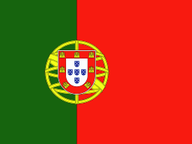


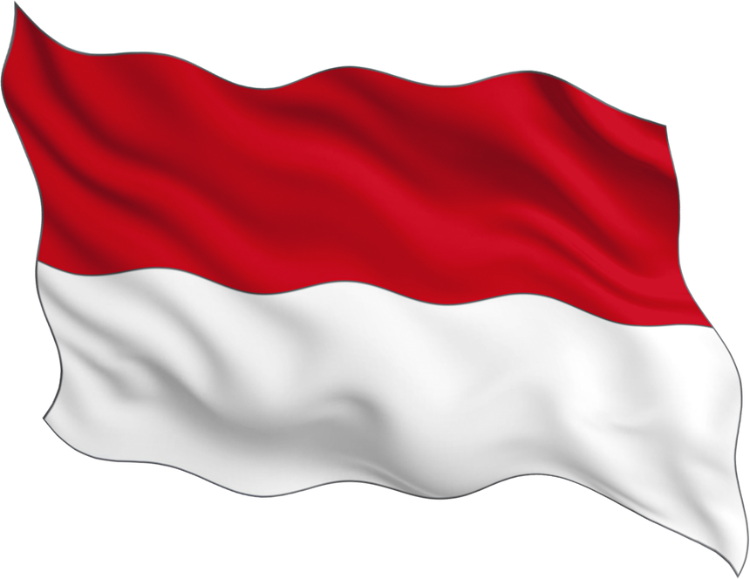
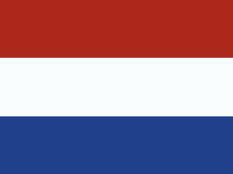
A Linguistic Spice Trade
Bandeira
Sapato
Flag
Shoes
Bendera
Sepatu
English Version
Koelkast
Handdoek
Fridge
Towel
Kulkas
Handuk

Slide 11




The "Slang" Indonesian Evolution
SANTUY
GAJE
KENAPSS
KERADD
BOSQUE
MANTUL

Slide 12
TERIMA KASIH
THANK YOU
Discovering the World’s Most Logical Language

